Slide 1

NLP Project: Hate speech Detection
12/30/2024

Slide 2
Team Members
 | Name | Email
1 | Keilor Fallas Prado | kfallasprado@gmail.com
2 | Ky Quang Dang | Keith.dang1610@gmail.com

Slide 3

Agenda
Executive Summary
Problem Statement
Approach
Results and Evaluation
Recommendations

Slide 4
Executive Summary
Problem Statement:
Detecting and addressing hate speech is a pressing concern to maintain a healthy online ecosystem, protect users from harm, and ensure regulatory compliance.
Business understanding:
Developing a hate speech detection model isn't just a technical challenge but also an effort to address real-world problems.
Deliveries:
The NLP model can detect hate speech and non-hate speech.
The report

Slide 5
Executive Summary
Approach:
Data: train shape (31962, 3) test shape(17197, 2), features (ids, tweet, labels)
Methodology: Transformer model (BERT, distilBERT)
Tools and Techniques: Mention any NLP techniques, libraries, or frameworks used (e.g., DistilBERT, emoji library, tokenization).
Model training and Evaluation:
Model Selection: Using DistilBERT (lighter than BERT) for efficient resources consumption.
Training Process: Trained model can achieve the high accuracy over 90% and loss is decreased after every epoch

Slide 6

Problem Statement
Hate speech is a form of communication, whether verbal, written, or behavioral, that attacks or discriminates against an individual or group based on their inherent characteristics, such as religion, ethnicity, nationality, race, gender, or other identity factors. The emergence of hate speech on social media platforms like Twitter poses significant challenges, including creating a toxic environment for users and impacting the platform's reputation.
Detecting and addressing hate speech is a pressing concern to maintain a healthy online ecosystem, protect users from harm, and ensure regulatory compliance.

Slide 7
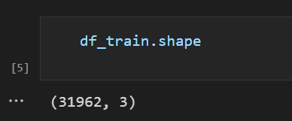
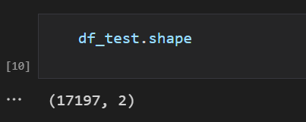
Approach
Data overview: Dataset consists of two subsets: train and test.
Train dataset: three features, including labels
Test dataset: two columns, without labels
Methodology:
Traditional neural learning such as: LTSM, GRU…
Transformer model, particularly pre-trained DistilBERT model.
Tools and Techniques:
Using deep learning to train and fine-tune the model on the training dataset.
Running model on Kaggle environment to leverage resources, high performance on training model, to save time every run time
Libraries: DistilBERT, emoji, pandas, numpy, matplotlib, re..etc.

Slide 8
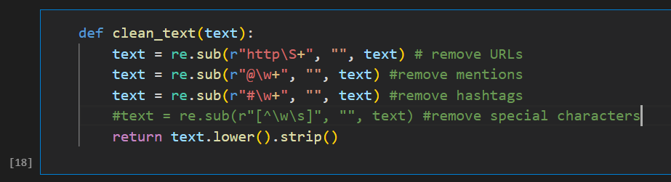
Data Preprocessing
Data cleansing:
Remove mentions (e.g @user,..)
Remove hashtags (e.g #)
Remove special charaters
Remove URLs
Remove Punctuation & Numbers
Convert to Lowercase: in this case of using BERT model, this step is unnecessary.

Slide 9
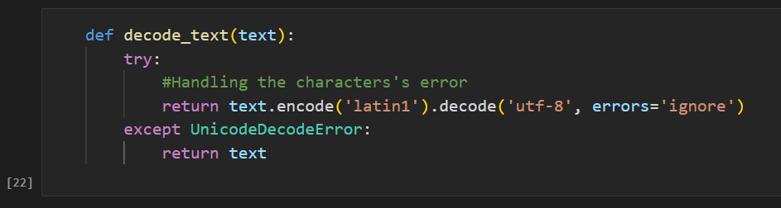
Data Preprocessing
Data transforming:
Decode text for handling the characters’s error
emoji-to-text conversion: Retaining emojis in tweets enhances the ability to accurately predict labels by preserving contextual meaning.

Slide 10
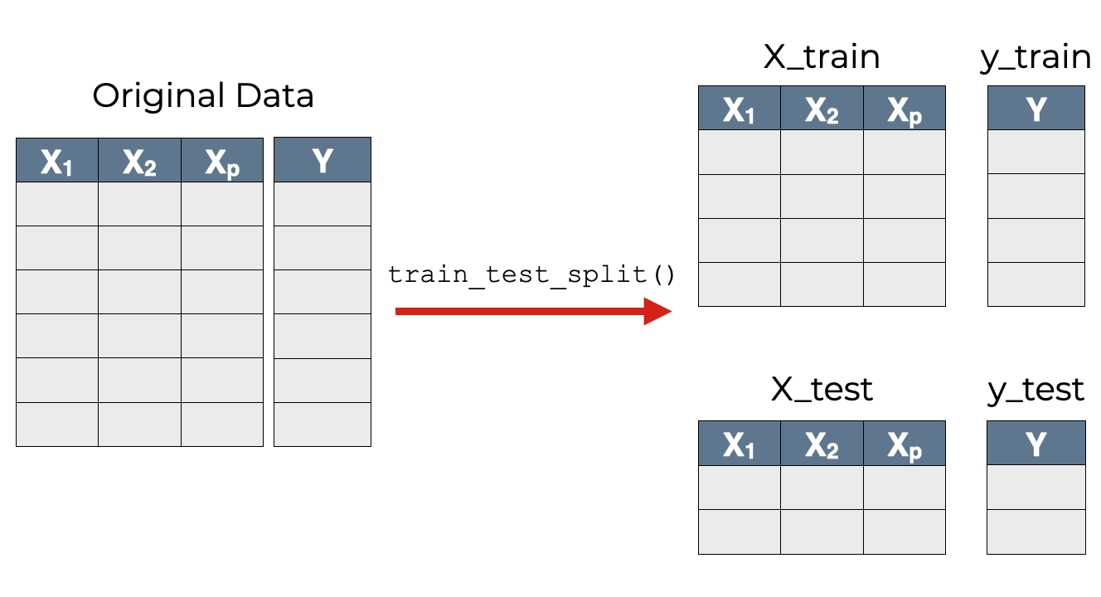
Data Preprocessing
Split data:
Split train dataset into two subsets train and test (with labels) consist of: X_train, y_train, X_test, y_test.
Train subset will be used for training model and the other one for evaluation.

Slide 11
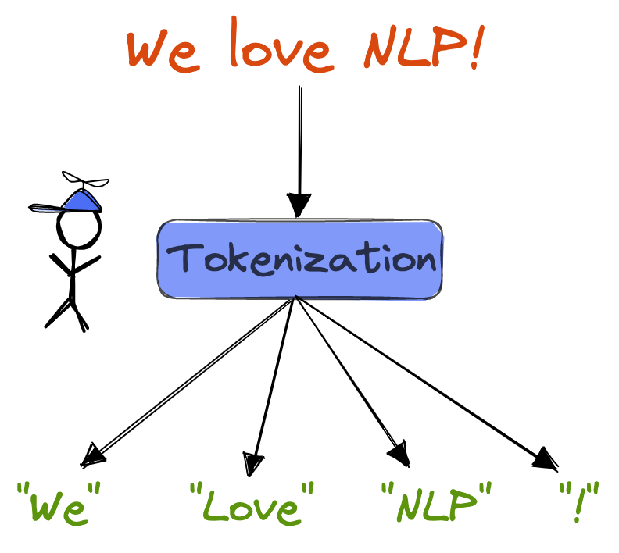
Data Preprocessing
Tokenization:
Using DistilBertTokenizer of tranformers library to tokenize tweet texts.
Check the max_length of tokenized texts by using:
lengths = [len(tokenizer.tokenize(tweet)) for tweet in new_train_df['deemoji_tweet']]
print(f“the max length: {max(lengths)}")
print(f“average length: {sum(lengths) / len(lengths)}")
Using appropriate max_length to balance both efficiency and performance.

Slide 12
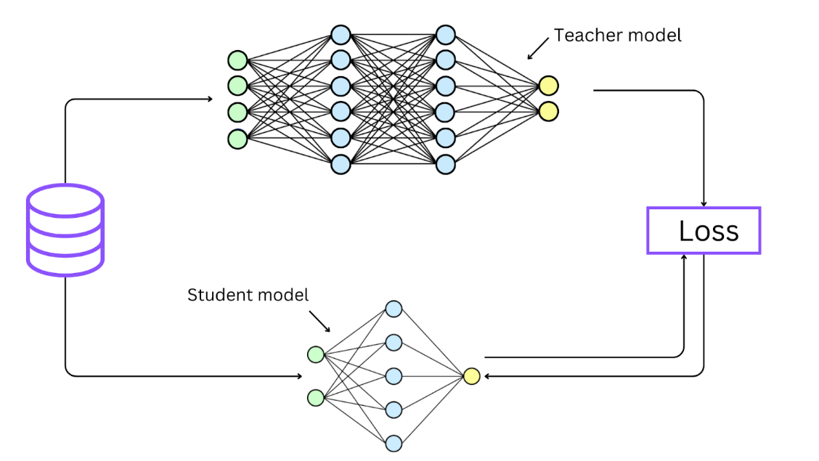
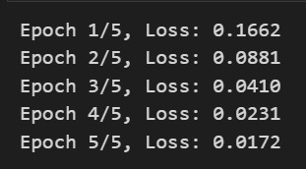
Model Training and Evaluation
Model training:
After tokenizing texts, we used these features of distilBERT model: DataLoader, TensorDataset, AdamW, epoch… to set up model training.
The loss received in each epoch tends to decrease, which proves the model is improving its performance, the model’s predictions are becoming more accurate

Slide 13
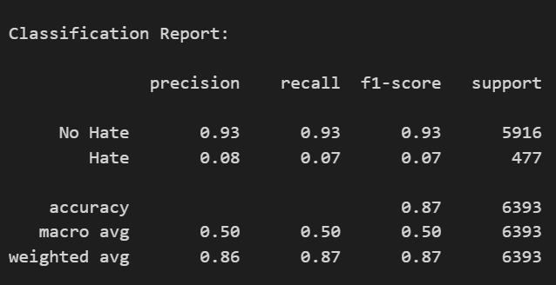
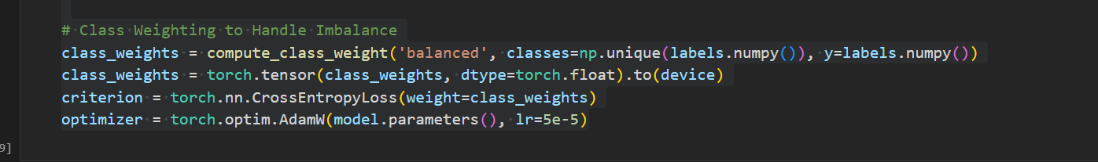
Model Training and Evaluation
Model Evaluation:
The overall accuracy of predictions on test subset and received the result of 87% along side with recall and f1-score.
The accuracy of detect hate speech is quite low due to the imbalanced classes of two labels, even though we added the improve method

Slide 14
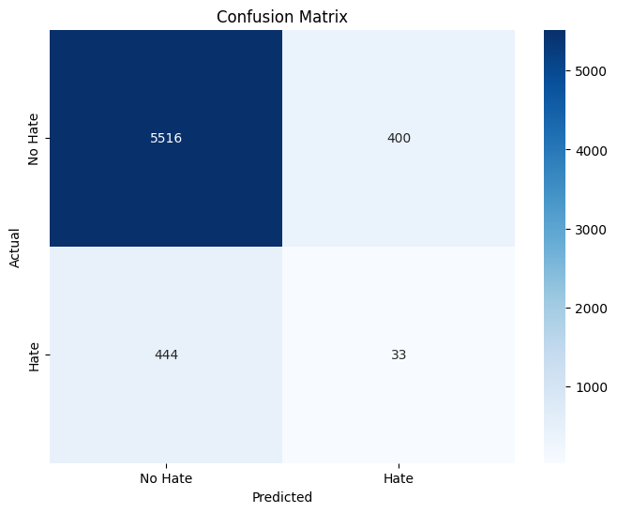
Model Training and Evaluation
Model Evaluation:
This confusion matrix shows the big difference between True Positives (True non-hate) and True Negatives (True-hate)

Slide 15
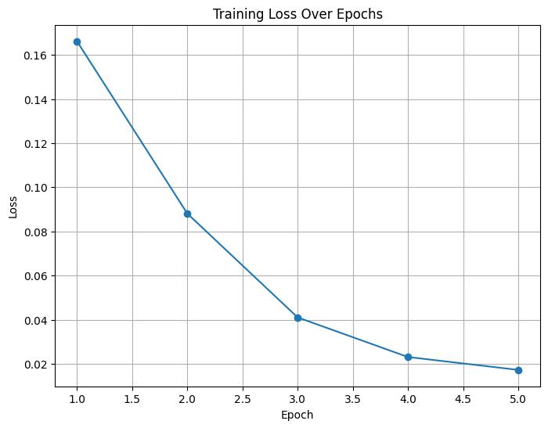
Model Training and Evaluation
Training Loss:

Slide 16
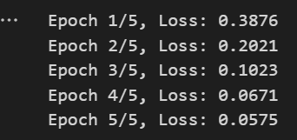
Model Improving and Reevaluation
Model training:
We adjusted a several code lines to rerun the model
The loss received in each epoch tends to decrease, which proves the model is improving its performance, the model’s predictions are becoming more accurate
New notebook file here:
Notebook_Link
Compressed model link:
NLP_final_model

Slide 17
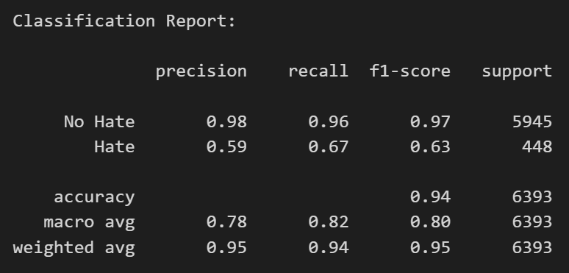
Model Improving and Reevaluation
Model Reevaluation:
The overall accuracy of predictions on the test subset from train dataset (x_test, y_test) improved from 87% (with the previous model) to 94% (with the rerun model), along with increases in recall and F1-score
The accuracy of detect hate speech significantly enhanced from 7% (with the previous model) to 59%.

Slide 18
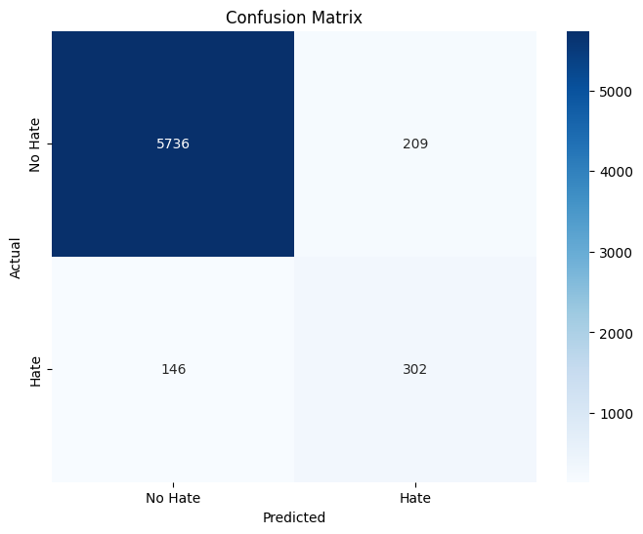
Model Training and Evaluation
Despite the difference in the two train-test splits, where the combinations of data were different, there is a noticeable improvement in accuracy.
Before After

Slide 19
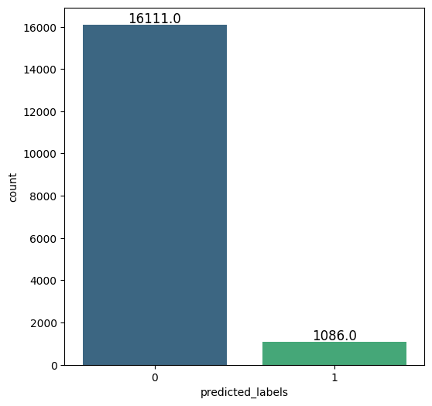
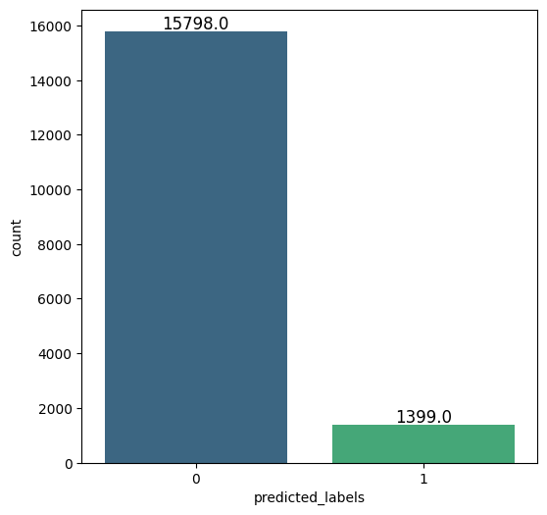
Test dataset Prediction
Before After

Slide 20
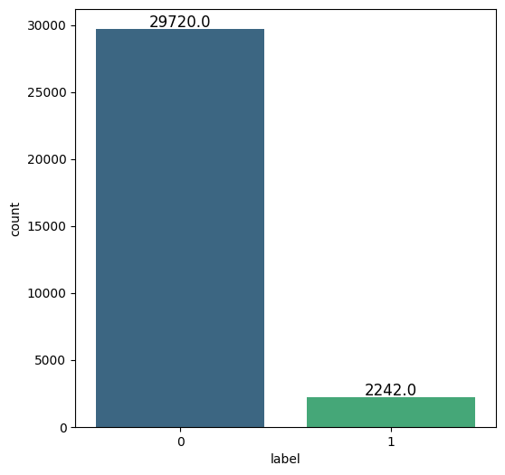
Challenges and Recommendations
Challenges:
The dataset has a significant imbalance between two classes
This issue has a significant impact to the predictions and accuracy, especially in detecting hate-speech
Inappropriate approach will not improve this problem.
Input Data (Train Subset: including X_train and X_test)

Slide 21
Challenges and Recommendations
Recommendations:
Although the accuracy of non-speech detection is considerably high and the improvement of hate detection’s accuracy, but the main target is the hate speech detection. The model should be improved in several times to achieve the desired performance.
The approach to address the imbalanced classes should be implemented before the train-test split.
Additionally, other pre-trained models from platforms like Hugging Face, such as emojiBERT or emoBERT, which require more energy and resources than we can allocate, may be better suited for the context due to their specialized features.

Slide 22
Thank You

